Slide 1
Buddhism

Slide 2
5 World Religions review
Guided Meditation

Slide 3
Buddhism
300 Million members worldwide
2500 years old
Founded by Siddhartha Gotama, or Buddha
Budhi means enlightened one

Slide 4
The Middle Path
Lead a moral life
Be mindful of thoughts and actions
Develop wisdom and understanding

Slide 5
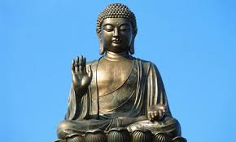
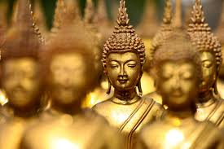
Buddha
Real guy
Nepal royal family
Realizes wealth isn’t the way
Studies the middle path to enlightenment
Teaches the principles of the middle path

Slide 6
4 Noble Truths
Life is Suffering
Suffering comes from wanting
Suffering can be overcome by giving up useless wanting.
The middle path ends suffering

Slide 7
5 Precepts of Buddhism
Take no life
Take nothing not feely given
Speak no lies
Avoid intoxication
Avoid overindulgence

Slide 8
Karma, Wisdom, Compassion
Part of the middle path
The life pursuit of a buddhist

