Slide 1
French and Indian War

Slide 3
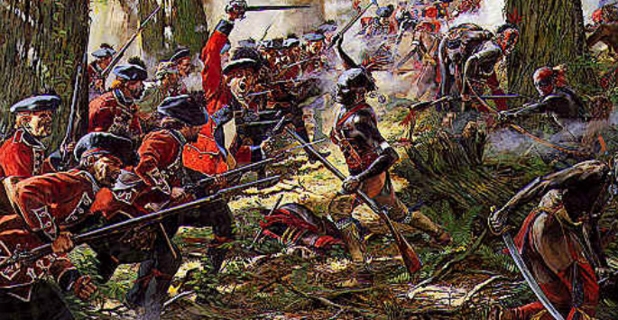
Growing Rivalry
France and Great Britain hate one another
Like a sibling rivalry: France v. GBR

Slide 4
What are they fighting for?
Fur
Trade
Mercantilism

Slide 5
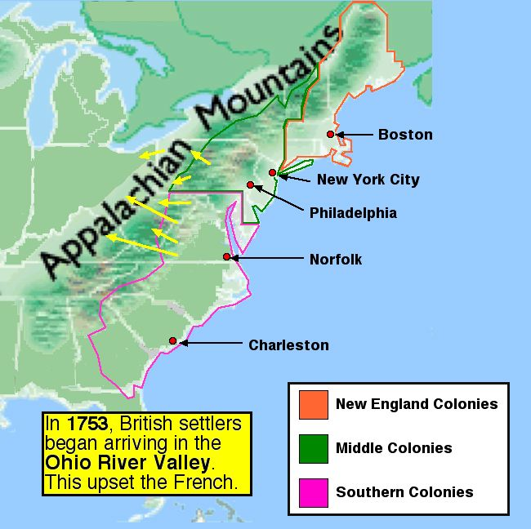
Starting War
France is trading in the Ohio River Valley
Colonists move in
Angers the French

Slide 6
Who owns the Ohio River Valley
No one, no one technically claimed it
Population growth and spreading among the colonists
British build forts in ORV, angering the F rench
Back and forth attacks

Slide 7
Native Americans
They like the French more than British
French don’t make permanent dwellings
French trade more fairly
French are more interested in trading than taking land

Slide 8
Iroquois Confederacy
6 tribes forming a government together
Mohawk, Seneca, Cayuga, Onondaga, Oneida, and the Tuscarora
Able to trade with both sides of the conflict and remain neutral

Slide 9
Fun Facts
Frequently called the 5 or 6 nations, the final nation joined after the confederacy had already been established; in 1722
Confederacy is a loose bundle of independent states

Slide 11
This is hitting the nail on the head
“No longer can the native peoples be seen as uncivilized and in need of assimilation. An idea that the colonizers falsely used for hundred[s] of years to legitimize the taking of indian lands, and the taking of culture through missionaries and the numerous policies to assimilate the native people of Turtle Island.”
Comparison and contrast of the Great Law of Peace. Taken from tuscaroras.com/graydeer/influence

Slide 12
Colonists attack
The Virginia governor sends a 21 year old surveyor and Major to “kick” the French out of the ORV
Fort Duqesne v. Fort Necessity

Slide 13
Fort Duquesne

Slide 14
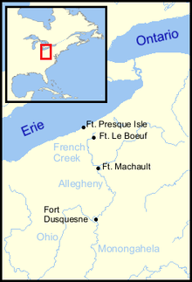
Fort Duquesne
The first fort built by the French in the ORV
Forks of the Ohio River
First major conflict
Washington fails miserably
The myth of Washington

Slide 15
Fort Necessity
A fort built by Washington’s men
The fort was a necessity, meaning it was a NEED not a want
Poor Washington loses again and is sent out of the Ohio River Valley

Slide 16
First attempt at a strong central government in the New World
Albany Plan of Union proposed by Ben Franklin
Collect taxes
Raise troops
Regulate trade
No one votes yes
“Everyone cries, a union is necessary, but when they come to the manner and form of the union, their weak noodles are perfectly distracted.”

Slide 17
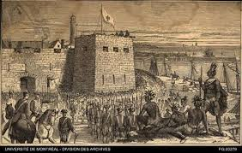
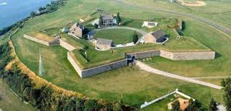
Fort Oswego
French Commander Montcalm takes Oswego
Indians are not as “gentlemenly” as the French

Slide 18
Fort William Henry
French lay siege to the fort
British send runner
Runner is killed
No help comes

Slide 19
Massacre at Fort William Henry
British surrender and the French allow those in the fort to leave safely
Huron culture does not work that way

Slide 20
William Pitt
Pitt doubles down
Money, troops, supplies

Slide 21
British victories
Louisbourg
Fort Duquesne- burned by the French

Slide 22
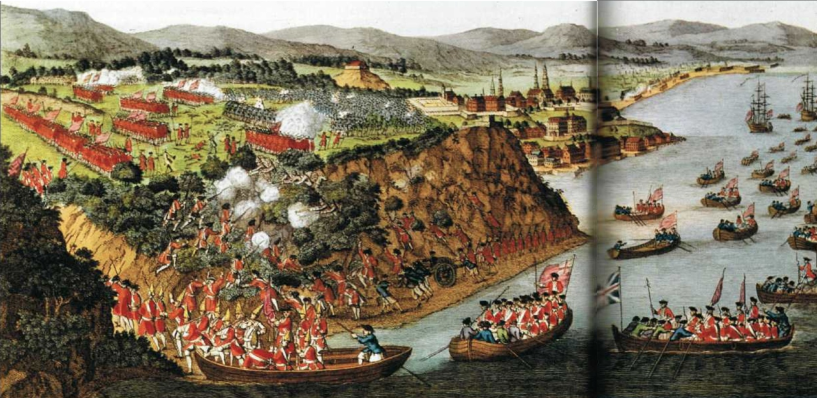
Battle of Quebec

Slide 23
Aftermath
Treaty of Paris, 1763
French give up claims to all of North American Possessions
All land west of the Mississippi and New Orleans goes to Spain
Land east of the Mississippi and Canada go to England

Slide 24
Aftermath
Pontiac’s War
Chief Pontiac of the Ottawa village near Detroit
Native Americans attack settlements
Proclamation of 1763
Says that the Appalachia mountains are the western boundary of the colonies

