Slide 1
Utah/Native American Relations
Chapter 7

Slide 2
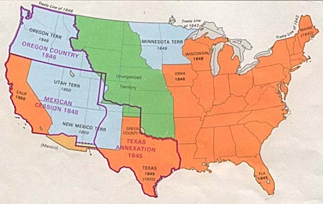
Mexican American War
1846-48
US wins the war, takes “Utah” from Mexico

Slide 3
What have we learned?
Think critically and let’s use what we have learned

Slide 4
Clash of Cultures
There’s just a huge difference here
Treatment of enemies during war
Treatment of disabled children
Do Mormon beliefs promote racism towards natives?
Settlers enter into a 5 way battle for territory

Slide 5
Conflicts
They all seem to have a similar problem here
To the Settlers, Indians are Indians, to Indians, settlers are settlers
The Settlers are overusing the land by indian standards
Under reporting or misreporting by settlers

Slide 6
1850
A Ute is Killed by 3 settlers in Provo
Under reporting
Salt Lake dispatches the militia to kill all ‘hostile’ warriors
One white soldier is killed and at least 26 Utes are killed, 11 Utes killed after the surrender

Slide 7
John W. Gunnison
Killed in 1853 near Manti
Killed by Pahvant Indians
Reports show that it was probably retribution for a white attack earlier

Slide 8
The Walker War
Settlers are ‘overusing’ the land, thousands of Mormons are migrating to Utah
Utes raid for food and supplies
Walkara begins leading raids against settlers, eventually drives a lot of settlers out of their towns
Trade dispute near Springville, a Ute is killed
Utes respond by killing militiamen at Fort Payson

Slide 9
The End of the Walker War
Brigham Young agrees to meet Walkara at Chicken Creek, Juab county
Walkara won’t come out of his tent
Walkara’s sick daughter
Brigham Young’s reaction

Slide 10
Goshute War
The Goshutes and Shoshone raid stagecoaches and travelers
US army shows up
When all is said and done 16 whites are killed and over one hundred Indians are killed

Slide 11
Bear River Massacre
Frightened travelers shoot and kill friendly Shoshone
Shoshone retaliate
Colonel Patrick Connor thinks that a group of Indians who were still friendly were responsible, they weren’t
“it is not our intention to take any prisoners”

Slide 12
Bear river, contd.
The attack happens in Southern Idaho
250 men women and children are killed
It’s not a good time, we’re just going to say it’s an actual massacre and we will leave it at that

Slide 13
Black Hawk War
Longest and most destructive conflict in Utah
Indian Agents want to move the Utes to the Uintah reservation and give up land
Utah’s trail of tears
Blackhawk realizes that his people are being taken advantage of

Slide 14
Tragedies in the Blackhawk War
Circleville Massacre
Black Hawk almost conquers Utah
Black Hawk’s walk of Peace

Slide 15
Posthumous tragedy
Miners dug up Black Hawks remains and eventually they were preserved and displayed his body in the LDS Church Museum of History
In 1996 the remains were returned and respectfully reburied

Slide 16
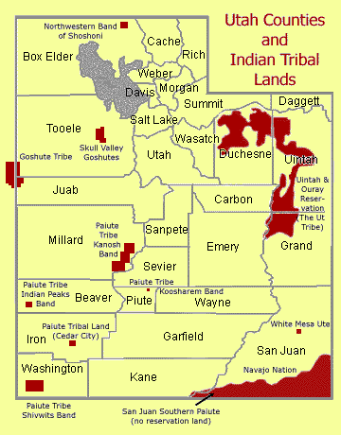
Indian Farms and Reservations
Reservations start out as “farms”

Slide 17
Jacob Hamlin
Missionary and friend to the Indians
Learned their Language
Widely respected

