Slide 1
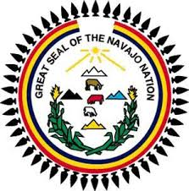
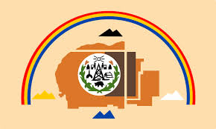
Navajo Culture

Slide 2
Navajo Creation
Navajo Creation
4 worlds
4 worlds represent 4 directions, 4 stones, 4 colors, 4 mountains
First Man and First Woman
4 Sacred Mountains
Mt. Blanca
Mt. Taylor
San Francisco Peak
Mt. Hesperus

Slide 3
Navajo Medicine Wheel

Slide 4
4 mountains

Slide 5
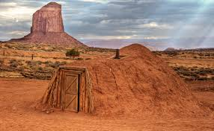
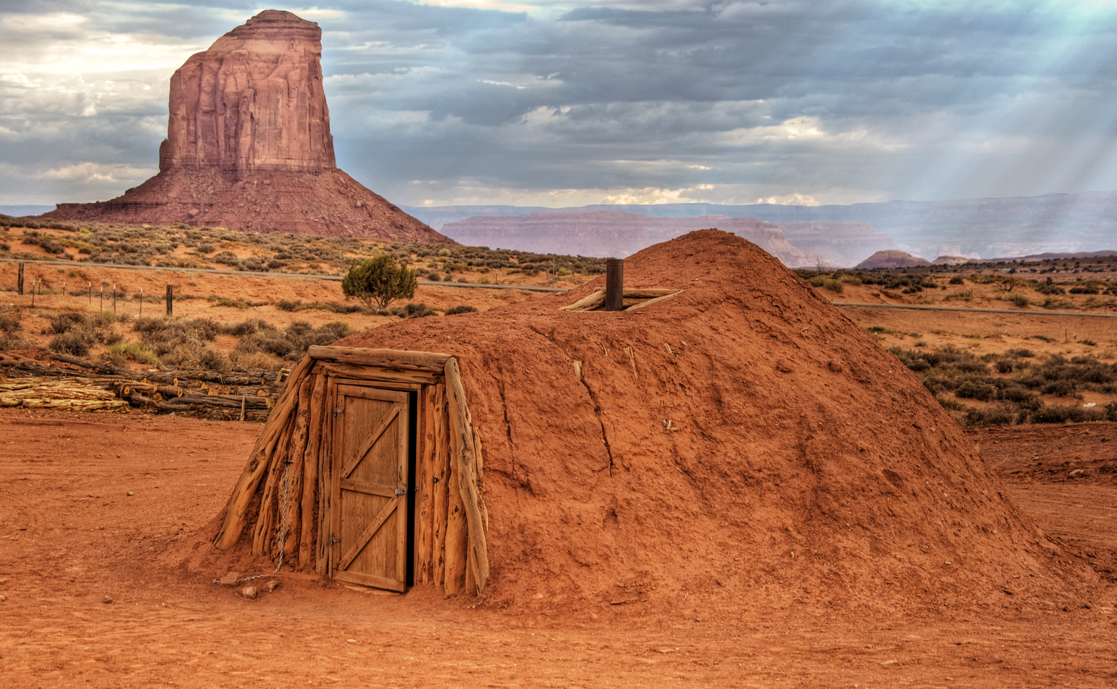
Living
The Navajo live in the Hogan
4 walls
Almost everything is a Symbol

Slide 6
We Shall Remain

Slide 7
European Contact
What do you think happens?
Spanish, Father Escalante
Horses, change the Navajo life forever

Slide 8
Long Walk of the Navajo
US Government kills Norbana (Chief) in 1849
Throughout the 1850’s US puts forts in Navajo territory
Raids begin and go back and forth, Navajo almost completely take over Fort Defiance
US War of Attrition… again

Slide 9
Long Walk Continued
8500 men, women, and children are made to march 300 miles from Arizona to New Mexico
Bosque Redondo Prison
Not enough space
Not enough food
Terrible living conditions

Slide 10
Treaty of Bosque Redondo
Establishes the Navajo Reservation
Fortunate placement of Reservation
Notable Signers
William Tecumseh Sherman
Manuelito
Barboncito

Slide 11
Navajo Leaders
Manuelito
Married Narbona’s Daughter
Many names
Great Leader of the Navajo

